Slide 1
به نام خالق قلم
استاجر : نیما برومند
استاد مربوطه : دکتر طباطبایی
مبحث : یبوست

Slide 2
Symptoms suggesting constipation in infants and children include infrequent bowel evacuation; hard, small feces; difficult or painful evacuation of large-diameter stools; and fecal incontinence (voluntary or involuntary evacuation of feces into the underwear, also known as encopresis) [1,2]. Most, but not all, children with fecal incontinence have underlying constipation.

Slide 3
اپیدمیولوژی
Constipation affects up to 30 percent of children and accounts for an estimated 3 to 5 percent of all visits to pediatricians [3,4]. The peak prevalence is during the preschool years in most reports. Functional constipation is responsible for more than 95 percent of cases of constipation in healthy children one year and older and is particularly common among preschool-aged children

Slide 10
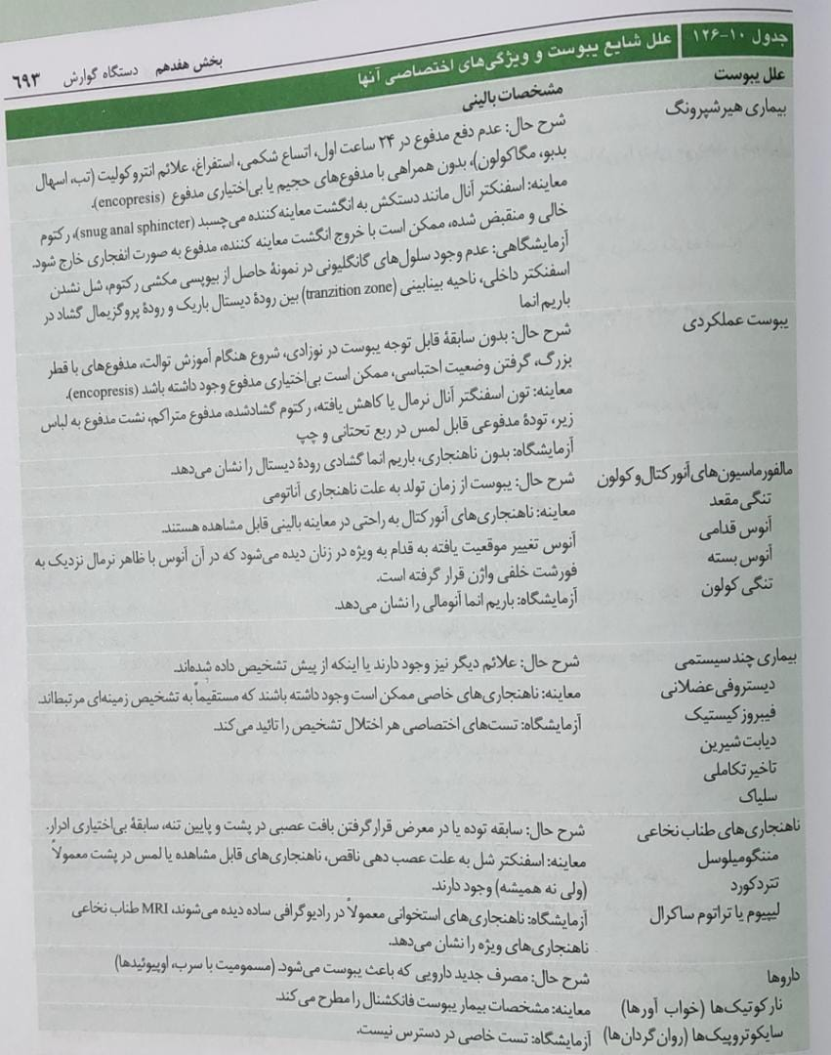

Slide 11
با تشکر از حسن توجه شما

